Slide 1

Phishing Awareness Training
This presentation will provide an overview of phishing attacks, explain how to recognize and avoid them, and discuss important steps for protecting yourself.
Made by:
Onkar Shahapurkar

Slide 2

What is Phishing?
1
Deceptive Emails
2
Stolen Information
Phishing attacks involve emails or messages that appear to be from a legitimate source, but are actually designed to trick you into giving away personal information.
The goal of a phishing attack is to steal your sensitive data, such as your login credentials, credit card information, or social security number.
3
Financial Loss
4
Cybercrime
Once the attackers have your information, they can use it to gain access to your accounts, make unauthorized purchases, or even steal your identity.
Phishing is a common form of cybercrime and can have serious consequences for individuals and businesses.

Slide 3
Common Phishing Tactics
Spoofed Email Addresses
Urgent Tone
Fake Websites
Phishers often use fake email addresses that closely resemble those of legitimate organizations. They might mimic a bank, online retailer, or government agency.
Phishing emails often use a sense of urgency or fear to pressure you into clicking a link or providing information. They might claim your account is compromised or that you need to verify your identity.
Phishing emails might include links to fake websites that look identical to real ones. These websites are designed to trick you into entering your sensitive information.

Slide 4
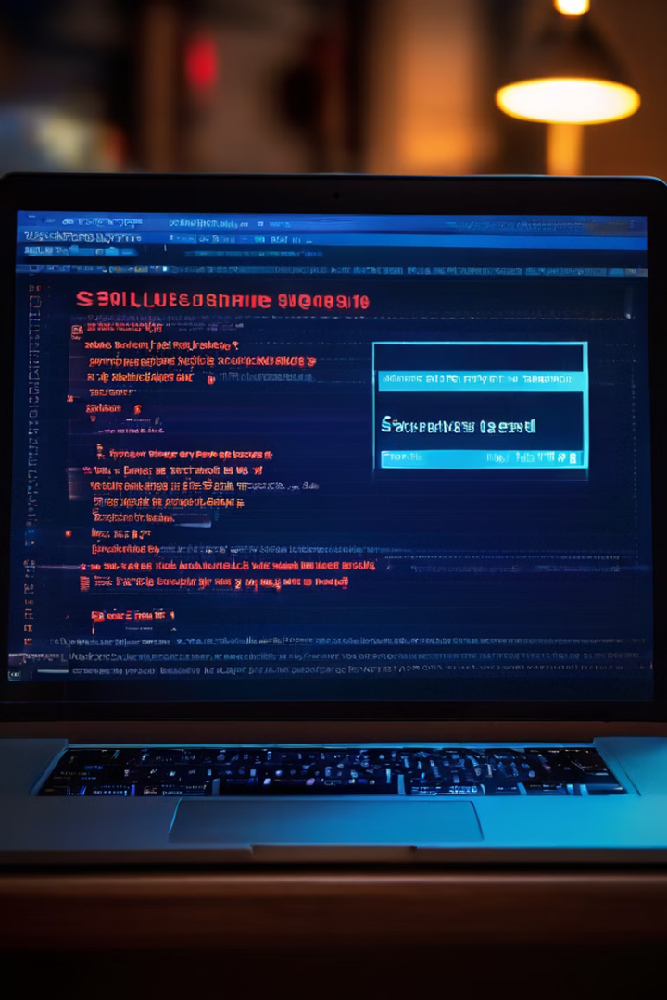
Identifying Phishing Emails
1
Check the Sender Address
Always carefully examine the email address of the sender. It should match the organization that it claims to be from. Be wary of misspellings or odd domains.
2
Inspect Links
Hover your mouse over any links in the email before clicking. The actual URL should be displayed in your browser's status bar and should match the link's text. Be suspicious of links that are shortened or go to unfamiliar websites.
3
Beware of Unusual Requests
Phishing emails often ask for personal information that legitimate organizations would not request over email, such as your password, credit card number, or social security number. Don't provide sensitive information through email unless you are absolutely certain it is legitimate.

Slide 5
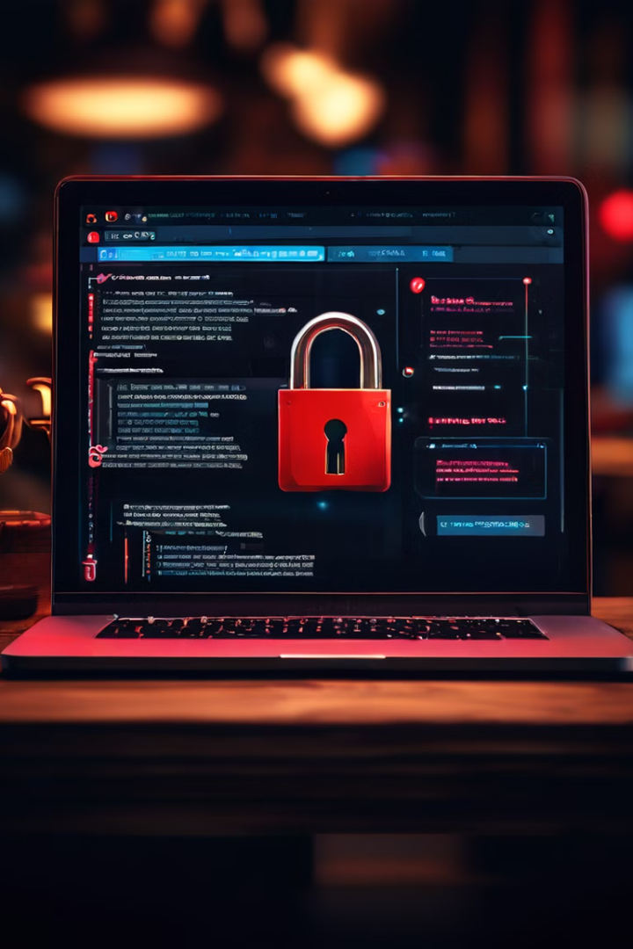
Recognizing Phishing Websites
Suspicious URL
Lack of Security
The website address might look strange, contain typos, or be a completely different domain than the legitimate organization's website. Look for misspellings or unusual characters.
Phishing websites often lack the security features found on legitimate websites, such as a secure connection (HTTPS). Check the address bar for the "https" prefix and a padlock icon.
Poor Design or Language
Request for Sensitive Information
Phishing websites often have poor design, grammatical errors, or strange language. They may look unprofessional or have a generic design.
Be wary of websites that ask for sensitive information, like your login credentials, financial data, or personal details, without a clear reason.

Slide 6





Social Engineering Techniques
Pretexting
Phishers create a believable story to convince you to share information. They might pretend to be a bank employee, a tech support representative, or a government official.
Baiting
They offer something attractive, like a free gift or a special offer, in exchange for your personal information. This can create a sense of urgency or temptation.
Scare Tactics
Phishers use fear or intimidation to trick you into acting impulsively. They might claim your account is compromised or that you are facing legal trouble.
Phishing Scams
These tactics are often used in combination with phishing emails or websites to create a more convincing facade.

Slide 7
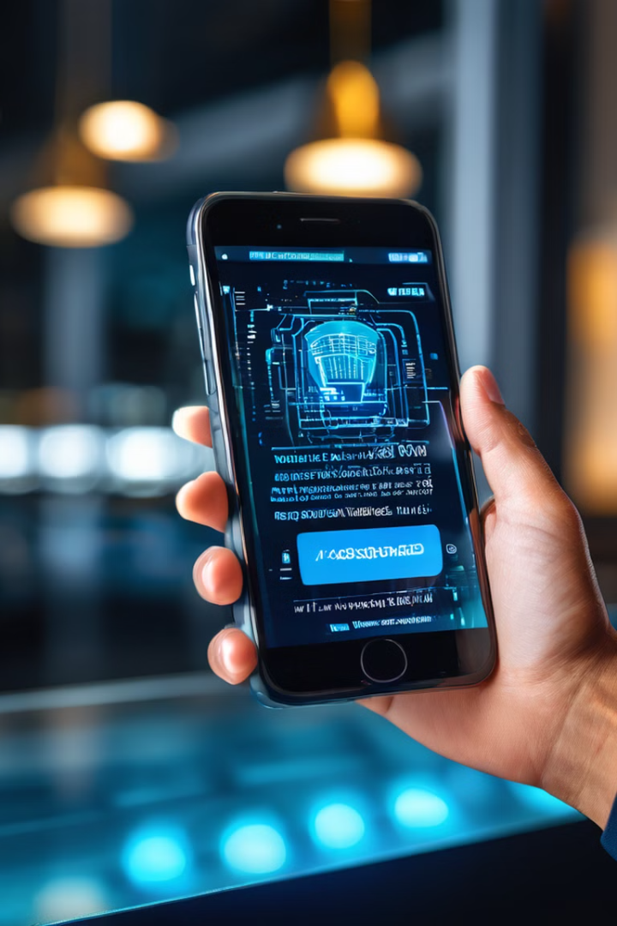




Protecting Yourself from Phishing
Strong Passwords
Enable Two-Factor Authentication
Use unique and strong passwords for all your online accounts. Avoid using the same password for multiple accounts. Use a password manager for safe storage.
Whenever possible, enable two-factor authentication for your online accounts. This adds an extra layer of security by requiring you to enter a code sent to your phone or email in addition to your password.
Be Cautious of Links and Attachments
Be Aware of Scams
Educate yourself about common phishing scams and be aware of the signs of a phishing attack. Never give out personal information unless you are certain it is legitimate.
Think twice before clicking on links or opening attachments in emails, even if they appear to be from a familiar source. Always verify the sender and the content before taking any action.

Slide 8

Reporting Suspected Phishing Attempts
Report to the Organization
If you receive a phishing email that appears to be from a legitimate organization, report it to that organization directly.
Contact Your Email Provider
Most email providers have reporting mechanisms for phishing emails. Use their tools to report suspicious emails and help prevent others from falling victim.
Report to the FTC
You can report phishing attempts to the Federal Trade Commission (FTC) at https://reportfraud.ftc.gov/

Slide 9


Importance of Phishing Awareness
Education
Prevention
Phishing awareness training is crucial for individuals and organizations to learn how to recognize and avoid these attacks.
By understanding phishing tactics, we can proactively protect ourselves from falling victim to these scams.

Slide 10
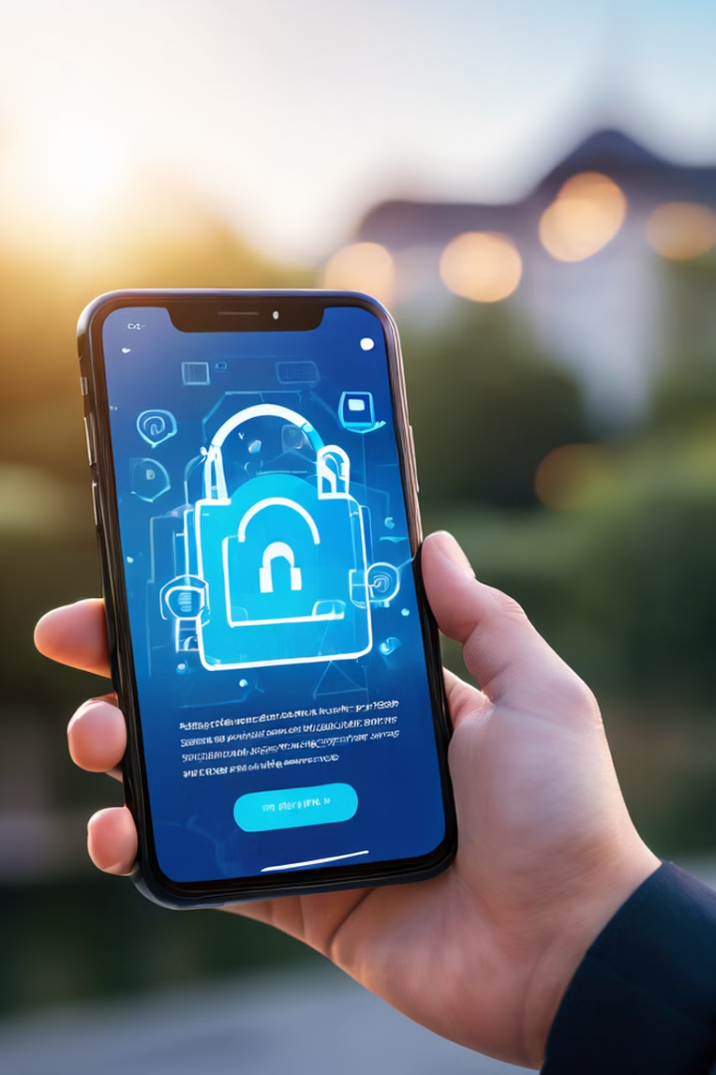
Conclusion and Key Takeaways
Phishing attacks are a serious threat, but with awareness and vigilance, we can protect ourselves. Always be cautious of suspicious emails, websites, and requests for personal information. By following best practices, we can stay safe online.

